Slide 1
Comparative vs. Superlative
9/5/2026
Comperative VS Superlative
1

Slide 2
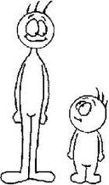
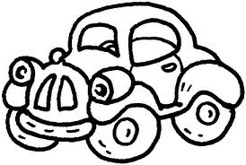
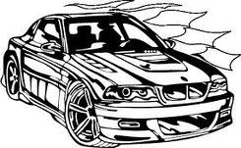
The Comparative is normally used if you want to compare two things, people,etc:
When we compare using short words (one or two sylabbles), we add –er + than at the end of the adjective.
Ex.
He is taller than me.
My car is cheaper than your car.

Slide 3
If an adjective ends in one vowel + consonant (a,e,i,o,u) (b,c,d,f,g,h,j,k,l,m....) we double the consanant and add -er
big - bigger
hot - hotter
thin - thinner
fat - fatter
If and adjective ends with a –y, we change it to –i and add –er
happy - happier
funny - funnier
easy - easier
ugly - uglier

Slide 4
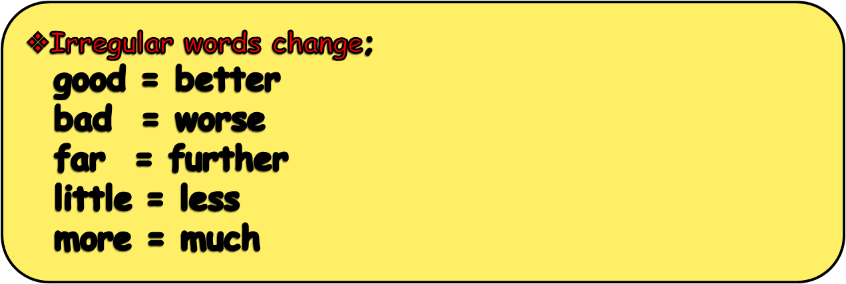
When we compare 2 things or people using long words (three or more sylabbles), we add more + adjective + than
Maria is more beautiful (adj) than Jennifer.
This book is more interesting than that book.
9/5/2026
Comperative VS Superlative
4

Slide 5
Write sentences using the words below:
interesting short
far expensive easy
Small
good
high
beautiful
bad
9/5/2026
Comperative VS Superlative
5

Slide 6
If you want to compare three or more things, people, etc. you use the Superlative: When using short words (one sylabble), we add the + adjective + –est.
ex:
Red car is the fastest of all / in the group
Dinosaur is the tallest.
9/5/2026
Comperative VS Superlative
6

Slide 7
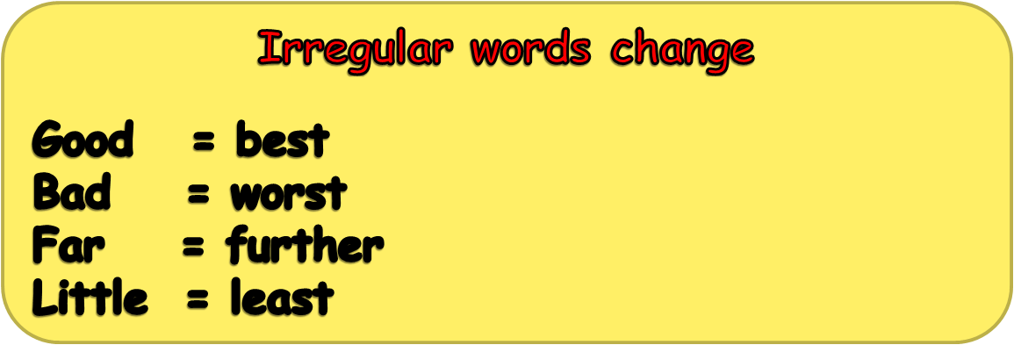
When using long words( three or more syllables) we add the most + adjective
ex:
He is the most intelligent
Student in the class.
She is the most beautiful girl in
the world.
9/5/2026
Comperative VS Superlative
7

Slide 8
creative tidy far important messy big good noisy handsome bad
Write sentences using the words below:
9/5/2026
Comperative VS Superlative
8

Slide 9
Short Adjectives
No. Syllables | Adjective | Comparative | Superlative
1 | short | shorter | the shortest
1 | high | higher | the highest
1 | cold | colder | the coldest
2 | simple | simpler | the simplest
2 | clever | cleverer | the cleverest
9/5/2026
Comperative VS Superlative
9

Slide 10
Long Adjectives
No of syllables | Adjective | Comparative | Superlative
4 | interesting | more interesting | most interesting
3 | beautiful | more beautiful | most beautiful
4 | intelligent | more intelligent | most intelligent
3 | expensive | more expensive | most expensive
3 | dangerous | more dangerous | most dangerous
9/5/2026
Comperative VS Superlative
10

Slide 11
Write the comparative form of the given adjectives:
intelligent
funny
carefull
small
boring
9/5/2026
Comperative VS Superlative
11

Slide 12
Which of the adjectives are irregular?
HOT - BIG - COLD - OLD - YOUNG - BAD - FAST - QUICK - LITTLE - SLOW - SHORT – COOL - GOOD - FAR - SMALL - LONG - LOW – HIGH - WIDE - LARGE - FEW - WARM - SMART
9/5/2026
Comperative VS Superlative
12

Slide 13


as ….. as
Cindy (beautiful) Pamela
Cindy is as beautiful as Pamela.
9/5/2026
Comperative VS Superlative
13

Slide 14


Gordon (fat) Tom
Tom is as fat as Gordon.
9/5/2026
Comperative VS Superlative
14

